Slide 1


Slide 2


BFAS Partner Connectivity Gateway
Nikolas Gavalas and Karl Ruetz

Slide 3



Best Friends Animal Society (bestfriends.org)
Who are we
Nation’s largest no-kill sanctuary for companion animals
Building programs to reduce number of animals entering shelters
Over one thousand network partners nationwide
Our mission
To bring about a time when there are No More Homeless Pets
No kill 2025
Reduce noses in, increase noses out
Notes:
Nik
Purritos
Not just dogs and cats, but also horses, goats, parrots, bunnies, pigs, and wild friends. Licensed by the federal government to restore wild animals.
Karl
No Kill - > 90% save rate.
Health and behavior reasons

Slide 4
Social Goodness
@BestFriends
@BestFriendsAnimalSociety
Facebook.com/BestFriendsAnimalSociety
linkedin.com/company/Best-Friends-Animal-Society
Notes:
Nik

Slide 5

Our Problem: Vast Amounts of Third Party Data
Constituent, Revenue
Custom Data (Bookings, Animal Data)
Accessed Different Ways
In Different Formats
Incoming and Outgoing
Data is often constituent entered and contains errors
Notes:
Karl

Slide 6
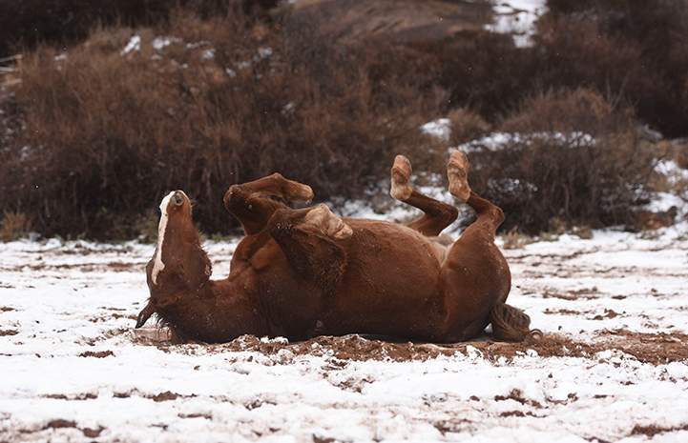
Incoming Types of Data From Third Parties
Visitor data from Checkfront
Cabin/Cottage/Tour bookings
REST API
Volunteer data from Digital Cheetah
Direct Database Access (MySQL)
Direct Mail Revenue from DMP
XML Files
Point of Sale from Springboard
REST API
Animal Care Data from Shelterluv
REST API
Notes:
Karl
Digital Cheetah MySQL access requires the installation of ODBC drivers for MySQL
DMP requires public facing SFTP server.

Slide 7
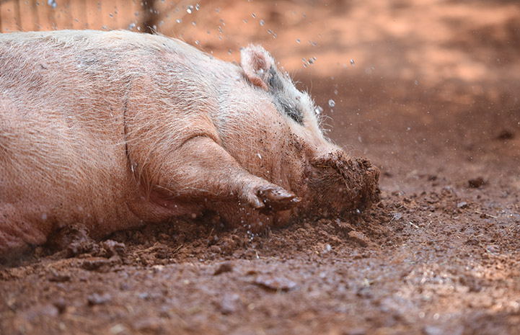
Outgoing Data Type To Third Parties
Constituent ID and Lookup ID to Digital Cheetah
Direct Database Access
Adoptable Animal Information to Rescue Groups
REST API
Notes:
Nik
Digital Cheetah uses Constituent ID and Lookup ID for deduplication.
Rescue Groups feeds hundreds of adoption sites around the world.

Slide 8

Our Solution: Partner Connectivity Gateway (PCG)
Notes:
Nik

Slide 9
What it is
3rd Party
The PCG is a server separate from the CRM.
A database and set of SSIS packages.
On the CRM
A common constituent business process
A common revenue process (global change)
One business process for each data source
Checkfront (Bookings)
Digital Cheetah (Volunteer timesheets)
Shelterluv (Adopted Animals)
PCG
CRM
Notes:
Karl
PCG
Tables for each data source and common tables for constituent and revenue information.
SSIS packages that pull data from remote sources and cleans them for insertion in the CRM.
Includes a common logging algorithm
Some packages return data to the sources or forward data to other third party sources.
Old Adoptable Animals process (the first PCG program) actually pulled data from our old ACS and forwarded it via FTP to other third party adoption sites.
Nik
CRM
Animals stored as inactive constituents.
Custom relationship type between adopters and animals

Slide 10
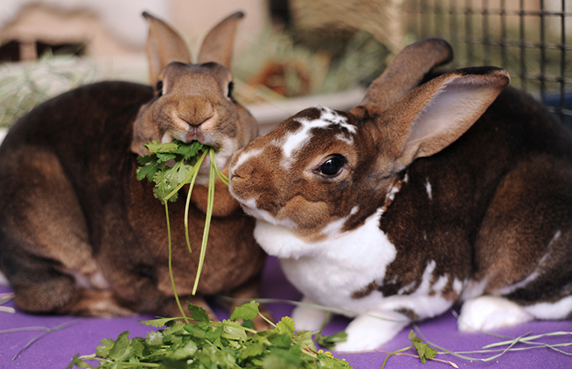
Benefits
Modular implementation of each new system
Consistent business rules for all processes
Primarily Constituents and Revenue
Provides the ability to clean the data
Ability to audit incoming and outgoing data
Separation of Data Acquisition and CRM Insertion gives increased reliability
One operation not dependent on the other
Notes:
Karl
One and two
Each new data partner can be added without major changes to existing processes.
Nik
Three, four and five

Slide 11
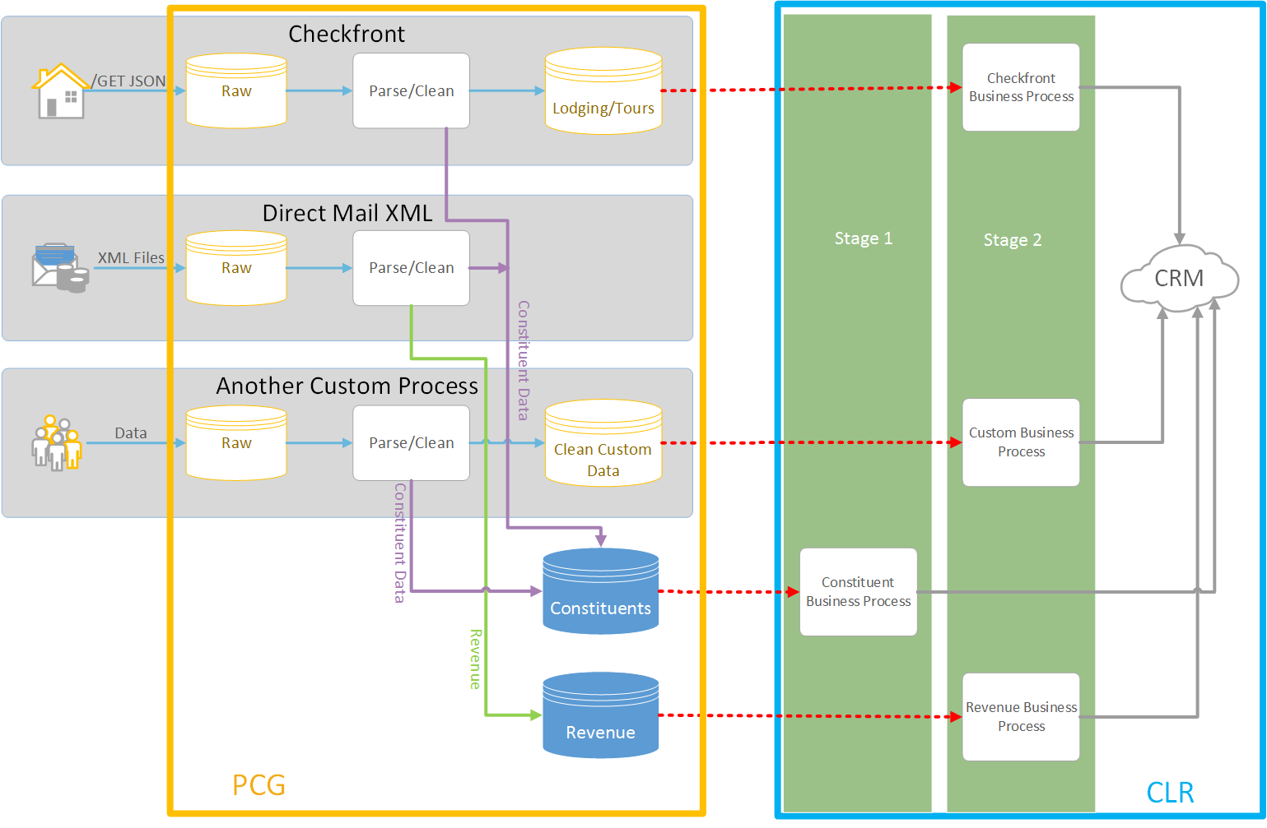
Notes:
Together but Nik Starts
Adding another process we just need to create another import process

Slide 12

Constituent Import (The big kahuna)
Linking between the CRM and PCG
Each constituent will have a unique alternate id that comes from the data source
Each imported item (transaction, booking, timesheet) is assigned a PCG ID by the PCG process
CRM Constituent ID and Lookup ID are drawn back from the CRM and stored in the PCG
Use Out of the box SPs as much as possible
Ensure we don’t miss anything
Stay on the upgrade path
Notes:
Karl
Linking
Explain the linking process
Use OOB SPs

Slide 13

Psuedo-code
Process all constituents with no CRM Constituent ID
Attempt to match
Three code paths
Matched – Update or add new contact info
Not matched – Create new constituent
Unsure – Send to batch
Notes:
Nik
Match percentages are configurable parameters.
Compound names are split into households with a custom relationship name based on the name of the integration.

Slide 14
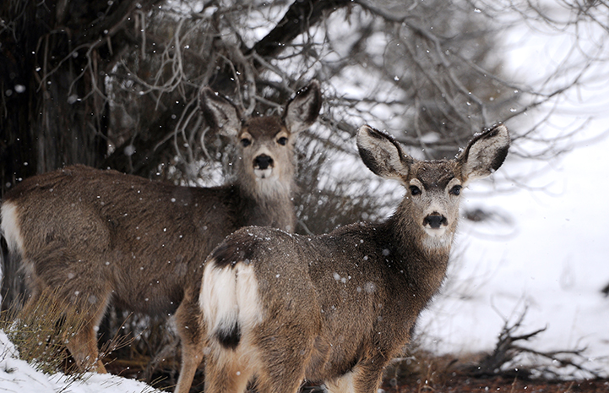
Constituent Import Batch
Create a constituent import batch
Automatically run import process
Batch is processed by Donor Services
Link constituents via alternate IDs
Next run of Business Process links Batched Constituents
Notes:
Nik

Slide 15
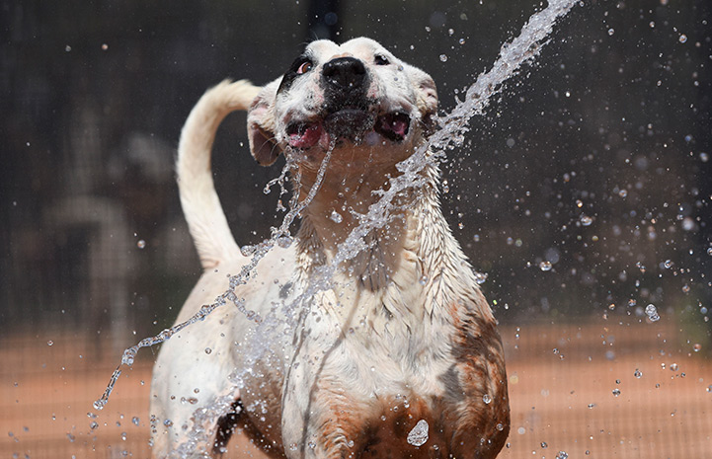
Run other processes
CRM Constituent ID and PCG ID are used to link the 3rd party data
Custom process adds data
Checkfront adds booking to a custom table that includes a custom List Builder
Digital Cheetah adds new volunteers and timesheets
Revenue adds revenue
Etc
Notes:
Karl

Slide 16

Q & A
www.bestfriends.org
What questions can we answer?

Slide 17


Thank you!
Karl Ruetz: karlr@bestfriends.org
Nik Gavalas: nikolasg@bestfriends.org

